Slide 1
Kafka stream Process

Slide 2
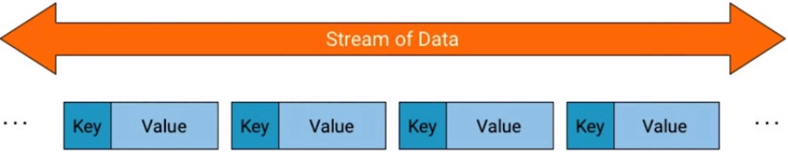
What is stream?
A stream is an unbounded, continuous flow of records
Data is real-time
Records are key-value pair

Slide 3
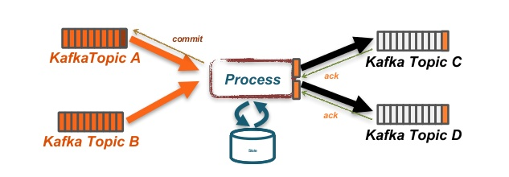
Kafka Streams
Kafka streams module is used when both input and output are in kafka.
Kafka connect is used for Extract and Load but to make complete ETL(Extract Transaction Load) we use Kafka streams framework.

Slide 4
Cont…
Kafka stream don't require separate processing cluster.*
(Confusion in above statement as different portals have contrasting information/opinion)

Slide 5
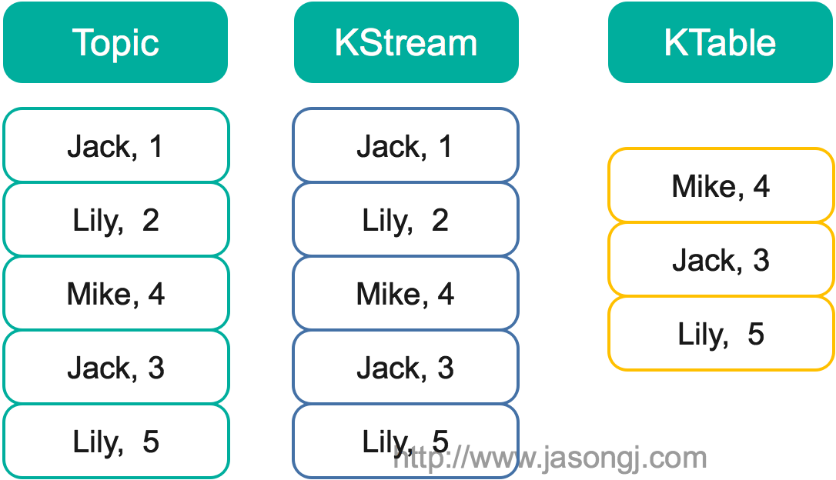
Cont.
We have two level of transformation.
KStream.
Ktable.

Slide 6

KTable
Ktable gets an upset when a record is found.
If record is already in the table then it will be updated, if not then inserted
Id | Product | Price ($)
1 | A | 3
2 | A | 5

Slide 7
KStream
Kstream is used when full history of data is required
We can do aggregation over it.
Id | Product | Price ($)
1 | A | 3
2 | A | 5

Slide 8
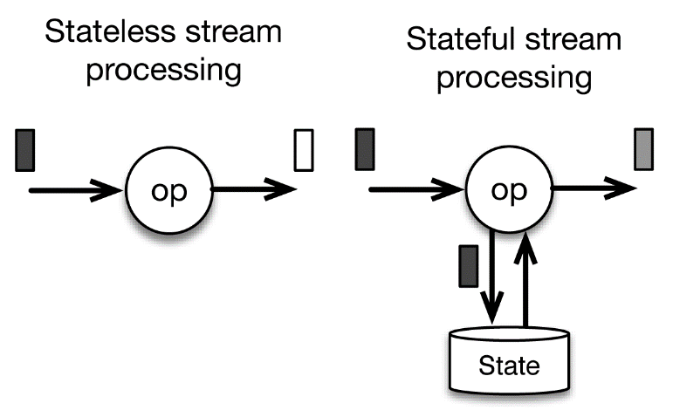
Cont.
Kstream transformations have two states
Stateful.
Stateless.

Slide 9
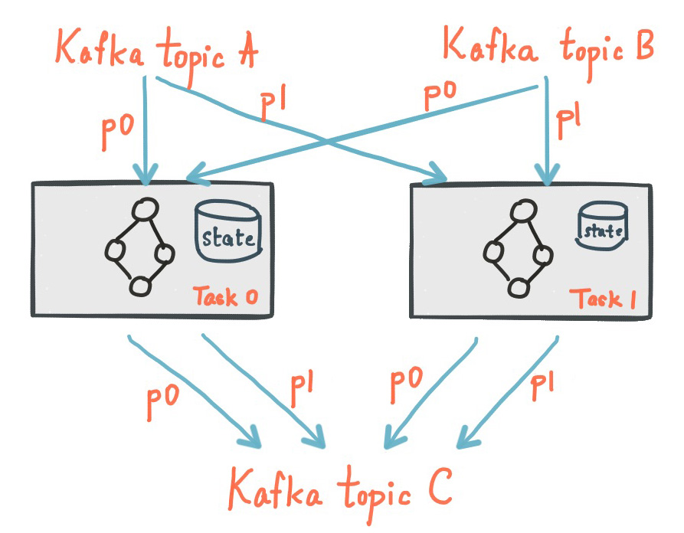
Stateful transformation
Those who need previous state of records
i.e. total average of sale of whole month
Stateful transformations are better at performance.

Slide 10
Stateless transformation
Those who don’t require previous records
i.e. if city = ‘isb’ then true else false;
Stateless transformations are better at fault tolerance.
Example
Map , Flat map , Filter ,etc.

Slide 11
Note
Kafka Streams is designed for building Kafka based stream processors where a stream input is a Kafka topic and the stream processor output is a Kafka topic.
Where Fit
If your use case is only producing messages to Kafka or only consuming messages from Kafka then a Kafka Streams based stream processor may be the right choice.
Where Not Fit
If you need to write your own code to build stream processors for more than just Kafka such as MongoDB or Redis or Cosmos DB, you may wish to consider alternatives such as Spark Streaming, Apache Flink or Apache Beam.

